Slide 1

Wooden dome shelter
Ákos Serfozo, Constantin Domenic Stancel, Jaehyun Park, Joppe Balbaert, Marine Cazelles, Ramon Marimon Farran

Slide 2
Outline
Problem
Objective
Project management
Marketing
Sustainability
Project development
  Door
  Window
  Junction nodes
Tests and results
Conclusion

Slide 3
Problem
High use of energy and materials in the world
Demand for sustainable housing

Slide 4
Objective
Design a wooden dome with:
  Diameter 6,8 m
  Automatic door
  Automatic window
  Efficient junction node
  Sustainable materials
Build a scale model

Slide 5
Project management
Useful techniques
  WBS
  Cost analysis
  R and R matrix
Insufficiently used techniques
  Communication register
  Stakeholder management

Slide 6
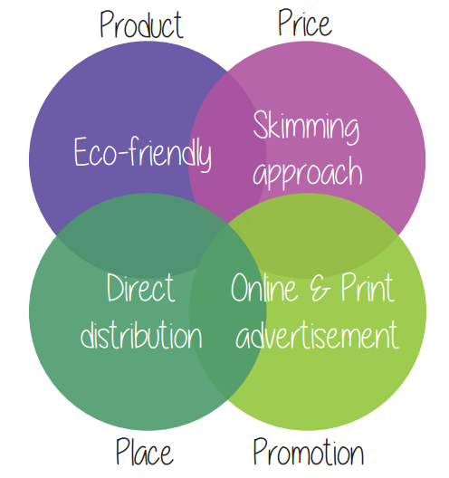
Marketing
Multifunctional alternative living environment with a small footprint

Slide 7
Sustainability
Sustainability highly valued by the team
Examples of sustainability measures:
  Use of oak for the beams
  Design of the automatic door

Slide 8
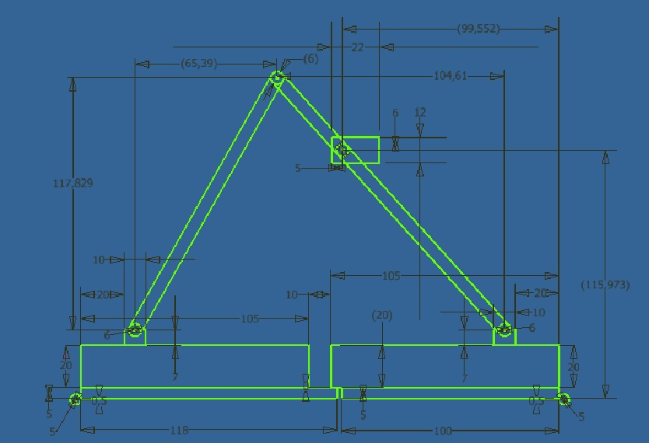
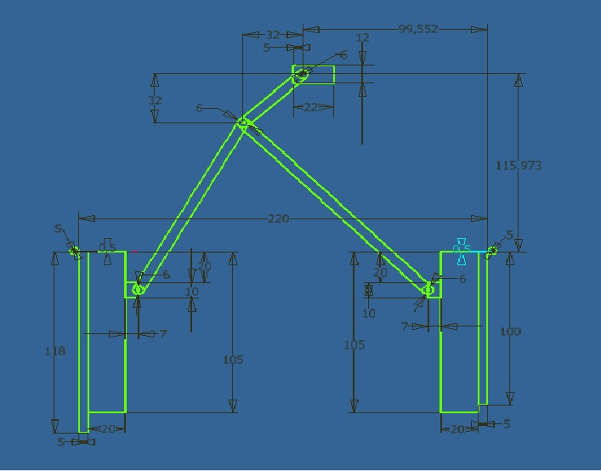
Project Development: Automatic Door
Concept of the door

Slide 9
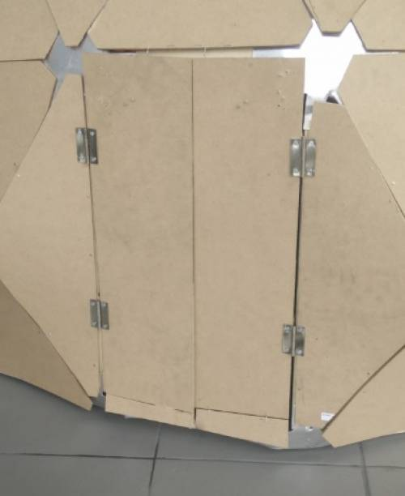
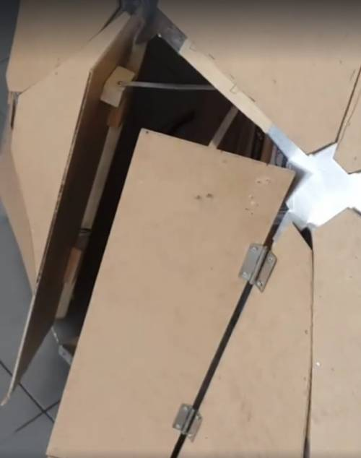
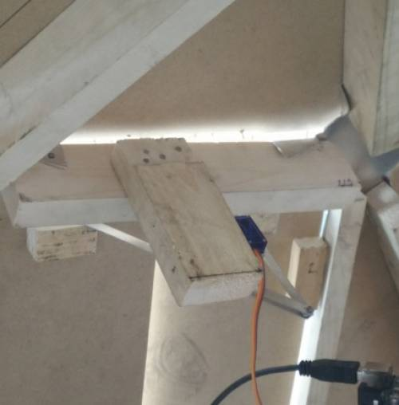
Project Development: Automatic Door (2)
Door in the scale model

Slide 10
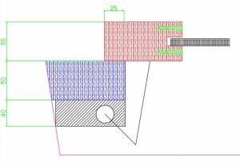
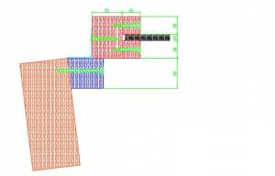
Project Development: Automatic Window
Concept of the window

Slide 11
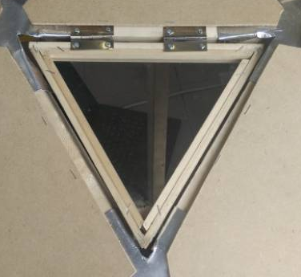
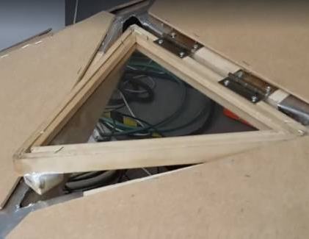
Project Development: Automatic Window (2)
Window in the scale model

Slide 12
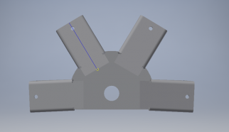
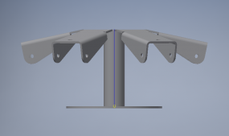
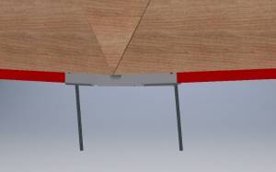
Project Development: Junction Node
Concept of the junction node
Special junction node foundation

Slide 13
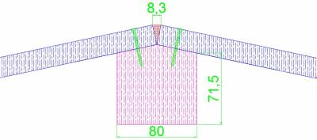
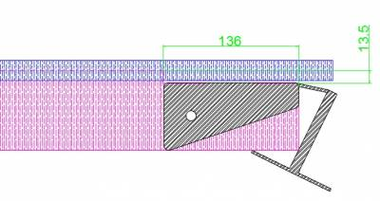
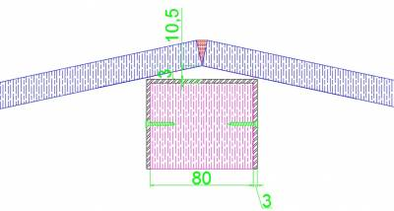
Project Development: Beams and Panels
Materials: Oak and plywood
Connection between beams and panels

Slide 14
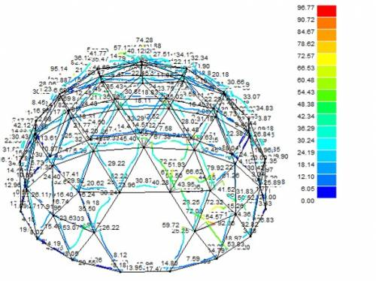
Tests and results
Simulation in PowerFrame
Result of the optimization process: 80 mm by 80 mm section

Slide 15
Tests and results (2)
Points of attention during assembly process
  Specific mark for each length of beam
  Mark positioning of beam on the junction node
  Clear instructions for each team working at the same time
  Build the door and window completely before implementation

Slide 16
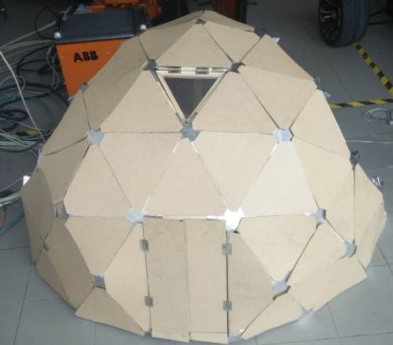
Tests and results (3)
Final result of the scale model
Window and door function correctly

Slide 17
Conclusion and future development
Project is the result of collaboration of a diverse team
Difficulties solved as a team
Future development
  Real conditions testing
  User-friendliness
  Interior design
  Implementation of function panels

