Slide 1

Wooden dome shelter
Ákos Serfozo, Constantin Domenic Stancel, Jaehyn Park, Joppe Balbaert, Marine Cazelles, Ramon Marimon Farran

Slide 2
Outline
State of the art
Project Management
Marketing
Sustainability
Ethics
Product development

Slide 3
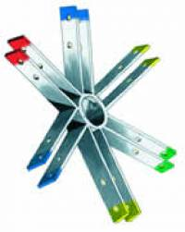
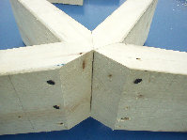
State of the art
 | Dome Kits | Timberline Geodesics
Connections
Material beams | Southern Pine | Douglas Fir
Material panels | Plywood | Plywood

Slide 4
State of the art (2)
Advantages | Disadvantages
Big volume, small surface | Complex design process
Aerodynamic | Waterproofness
Natural air circulation | Need for custom fitting

Slide 5
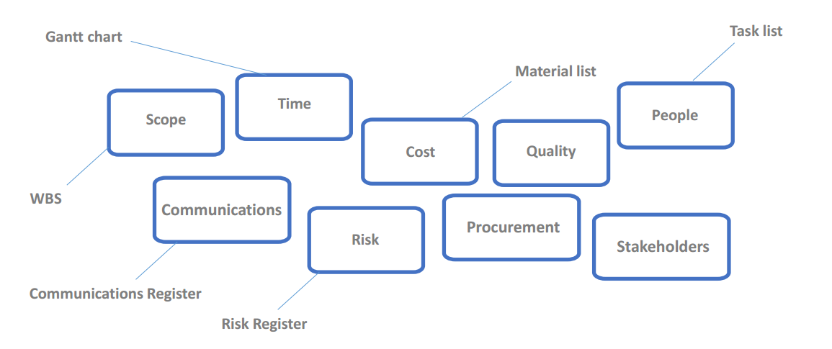
Project Management

Slide 6

Marketing: Target Market

Slide 7
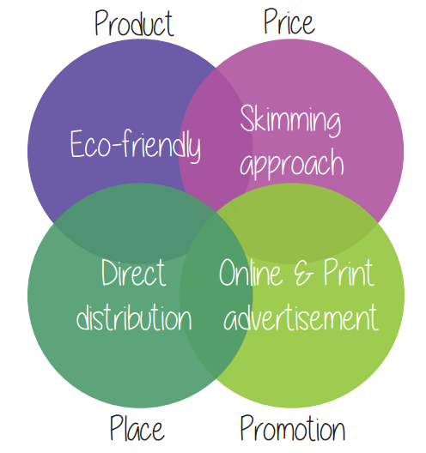
Marketing Mix

Slide 8
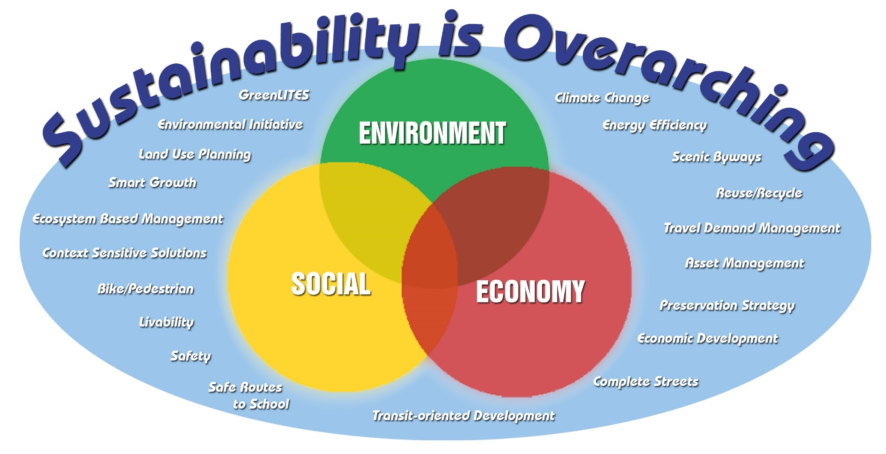
Sustainability

Slide 9

Sustainability (2)
Sustainability is the capacity to endure; it is how biological systems remain diverse and productive indefinitely.

Slide 10

Ethical and Deontological Concerns
“Ethics is knowing the difference between what you have a right to do and what is right to do.” - Potter Stewart
Codes of ethics are present in all the aspects of our life such as personal or professional.

Slide 11
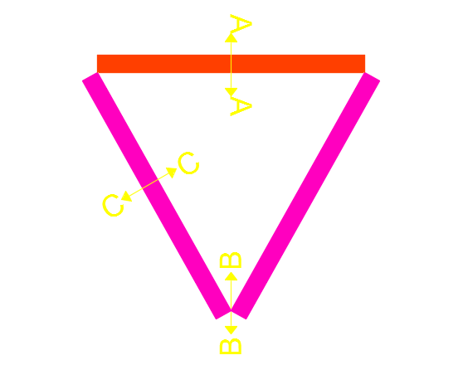
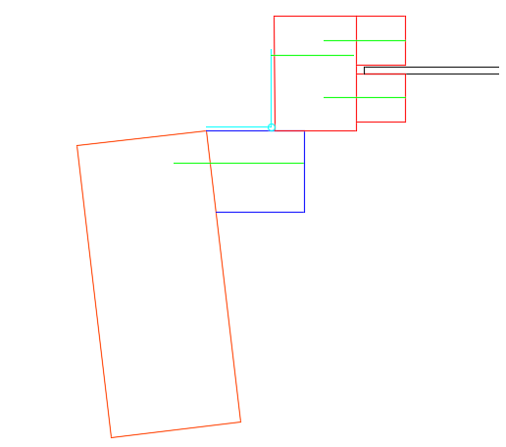
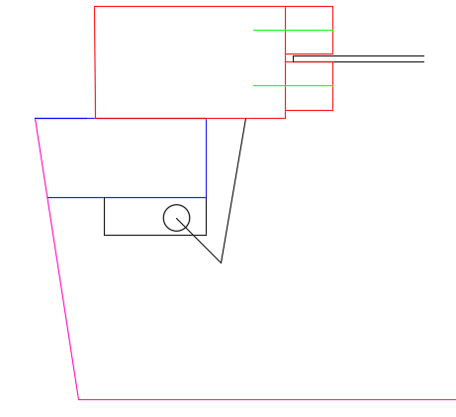
Project Development

Slide 12
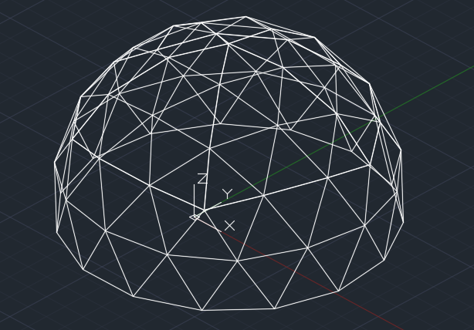
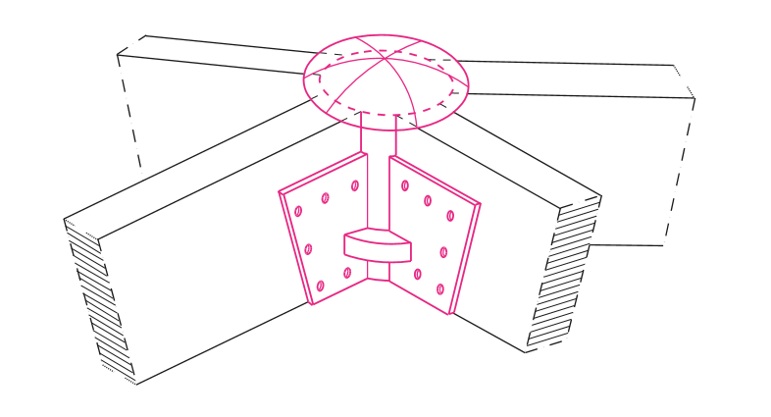
Project Development (2)

Slide 13
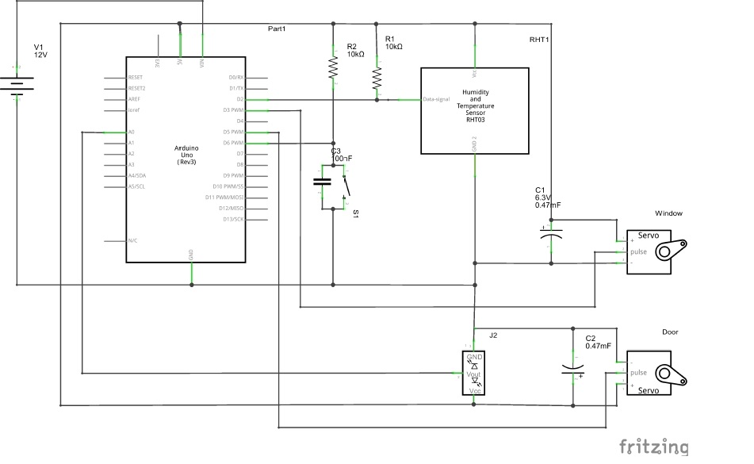
Project Development (3)

Slide 14
Conclusion
How did we develop the project during the first months?
What do we still have to do?
  Improve previous work
  Calculation of the dome structure
  Further development of functionalities
  Build the prototype and test it

